Slide 1

Digital Health Companion Fianl Presentation
Pentagon Nexus Consulting Group
Simon Sarkodie 8960492
Mohana Dutta 8990773
Ya-Jwu Jang 9015996
Meet Patel 9019384
Vasukrishna Bhalodia 9018135
Notes:
Capstone Project
Blair Moch
INFO8687
Section 1
Sept. 22 2025
Simon Sarkodie 8960492
Mohana Dutta 8990773
Ya-Jwu Jang 9015996
Meet Rajendrakumar Patel 9019384
Vasukrishna Ashokkumar Bhalodia 9018135

Slide 2
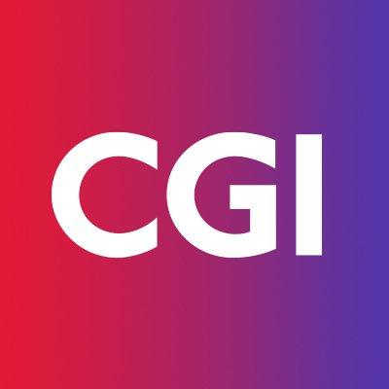

Table of Contents
1 | Project Context & Foundation
2 | Requirements & Analysis
3 | Solution Design & Evaluation
4 | Implementation Planning
5 | Conclusion

Slide 3
About Pentagon Nexus Consulting Group
⁠Founded in 2015, HQ in Waterloo, Canada, FY2024 revenue: CAD $1.2B
⁠IT consulting firm with 1,000+ employees, operating 5 additional offices across Canada
Over the past 10 years, the firm has supported more than 50 clients
Serves government, finance, telecom, healthcare, and manufacturing
Provides digital strategy, enterprise solutions, cloud modernization, and cybersecurity

Slide 4





Team Pentagon Nexus Consulting Group
Mohana Dutta
Meet Petel
Julie Jang
Simon Sarkodie
Vasurishna Bhalodia
Project Manager
Associate Project Manager
Business Analyst
Business Analyst
Business Analyst
Notes:
Roles and responsibility

Slide 5

1
Project Context & Foundation
Opportunity & Problem Statement
Project Scope & Charter

Slide 6
CGI SWOT Summary
MARS
VENUS
JUPITER
SATURN
Strengths
Weaknesses
Strong government-contract base Global presence (90k employees) Stable revenue & high client retention Broad IT & consulting capabilities | Heavy reliance on public sector Slow decision-making (large org) Lower presence in commercial markets Limited adoption of emerging tech at scale
Growth in digital health, AI, cloud Private-sector expansion (health, finance, retail) Acquisition-driven growth Rising use of wearables & digital care tools | Strong global competitors Public scrutiny on government projects Fast tech evolution Regulatory & geopolitical risks
Opportunities
Threats
Mars is actually a very cold place
Venus is the second planet from the Sun
It’s the biggest planet in the System
Saturn is a gas giant and has rings

Slide 7
CGI SWOT Summary
MARS
VENUS
JUPITER
SATURN
Strengths
Strong government-contract base Global presence (90k employees) Stable revenue & high client retention Broad IT & consulting capabilities | Heavy reliance on public sector Slow decision-making (large org) Lower presence in commercial markets Limited adoption of emerging tech at scale
Growth in digital health, AI, cloud Private-sector expansion (health, finance, retail) Acquisition-driven growth Rising use of wearables & digital care tools | Strong global competitors Public scrutiny on government projects Fast tech evolution Regulatory & geopolitical risks
Weaknesses
Opportunities
Threats
Mars is actually a very cold place
Venus is the second planet from the Sun
It’s the biggest planet in the System
Saturn is a gas giant and has rings

Slide 8
CGI SWOT Summary
MARS
VENUS
JUPITER
SATURN
Weaknesses
Strong government-contract base Global presence (90k employees) Stable revenue & high client retention Broad IT & consulting capabilities | Heavy reliance on public sector Slow decision-making (large org) Lower presence in commercial markets Limited adoption of emerging tech at scale
Growth in digital health, AI, cloud Private-sector expansion (health, finance, retail) Acquisition-driven growth Rising use of wearables & digital care tools | Strong global competitors Public scrutiny on government projects Fast tech evolution Regulatory & geopolitical risks
Opportunities
Threats
Mars is actually a very cold place
Venus is the second planet from the Sun
It’s the biggest planet in the System
Saturn is a gas giant and has rings

Slide 9
CGI SWOT Summary
MARS
VENUS
JUPITER
SATURN
Strong government-contract base Global presence (90k employees) Stable revenue & high client retention Broad IT & consulting capabilities | Heavy reliance on public sector Slow decision-making (large org) Lower presence in commercial markets Limited adoption of emerging tech at scale
Growth in digital health, AI, cloud Private-sector expansion (health, finance, retail) Acquisition-driven growth Rising use of wearables & digital care tools | Strong global competitors Public scrutiny on government projects Fast tech evolution Regulatory & geopolitical risks
Weaknesses
Opportunities
Threats
Mars is actually a very cold place
Venus is the second planet from the Sun
It’s the biggest planet in the System
Saturn is a gas giant and has rings

Slide 10
CGI SWOT Summary
MARS
VENUS
JUPITER
SATURN
Strong government-contract base Global presence (90k employees) Stable revenue & high client retention Broad IT & consulting capabilities | Heavy reliance on public sector Slow decision-making (large org) Lower presence in commercial markets Limited adoption of emerging tech at scale
Growth in digital health, AI, cloud Private-sector expansion (health, finance, retail) Acquisition-driven growth Rising use of wearables & digital care tools | Strong global competitors Public scrutiny on government projects Fast tech evolution Regulatory & geopolitical risks
Weaknesses
Threats
Opportunities
Mars is actually a very cold place
Venus is the second planet from the Sun
It’s the biggest planet in the System
Saturn is a gas giant and has rings

Slide 11

Problem Statement
Over-dependence on public-sector revenue
Low brand penetration in private-sector health tech
High exposure to policy, budget cycles
Competitors (Accenture, Infosys, TCS) are more diversified
Need a scalable digital product to: ✔ diversify revenue ✔ reduce risk ✔ expand digital health footprint

Slide 12

Problem Statement
Over-dependence on public-sector revenue
Low brand penetration in private-sector health tech
Over-dependence on public-sector revenue
Low brand penetration in private-sector health tech
High exposure to policy, budget cycles
Competitors (Accenture, Infosys, TCS) are more diversified
Need a scalable digital product to: ✔ diversify revenue ✔ reduce risk ✔ expand digital health footprint

Slide 13

Problem Statement
Over-dependence on public-sector revenue
Low brand penetration in private-sector health tech
High exposure to policy, budget cycles
Over-dependence on public-sector revenue
Low brand penetration in private-sector health tech
High exposure to policy, budget cycles
Competitors (Accenture, Infosys, TCS) are more diversified
Need a scalable digital product to: ✔ diversify revenue ✔ reduce risk ✔ expand digital health footprint

Slide 14

Problem Statement
Over-dependence on public-sector revenue
Competitors (Accenture, Infosys, TCS) are more diversified
Low brand penetration in private-sector health tech
High exposure to policy, budget cycles
Over-dependence on public-sector revenue
Low brand penetration in private-sector health tech
High exposure to policy, budget cycles
Competitors (Accenture, Infosys, TCS) are more diversified
Need a scalable digital product to: ✔ diversify revenue ✔ reduce risk ✔ expand digital health footprint

Slide 15
Problem Statement
Low brand penetration in private-sector health tech
Over-dependence on public-sector revenue
Competitors (Accenture, Infosys, TCS) are more diversified
High exposure to policy, budget cycles
Over-dependence on public-sector revenue
Low brand penetration in private-sector health tech
High exposure to policy, budget cycles
Competitors (Accenture, Infosys, TCS) are more diversified
Need a scalable digital product to: ✔ diversify revenue ✔ reduce risk ✔ expand digital health footprint

Slide 16
Problem Statement
Low brand penetration in private-sector health tech
Over-dependence on public-sector revenue
Competitors (Accenture, Infosys, TCS) are more diversified
Need a scalable digital product to: ✔ diversify revenue ✔ reduce risk ✔ expand digital health footprint
High exposure to policy, budget cycles
Over-dependence on public-sector revenue
Low brand penetration in private-sector health tech
High exposure to policy, budget cycles
Competitors (Accenture, Infosys, TCS) are more diversified
Need a scalable digital product to: ✔ diversify revenue ✔ reduce risk ✔ expand digital health footprint

Slide 17
Data Analysis
Public sector projects = slow procurement, high political risk
Limited presence in high-growth private-sector markets (AI, healthcare, fintech)
Opportunity
Notes:
CGI’s business heavily relies on government IT contracts

Slide 18
Opportunity Statement
Public sector projects = slow procurement, high political risk
Limited presence in high-growth private-sector markets (AI, healthcare, fintech)
Opportunity
Launch a B2B2C Digital Health Companion App, leveraging CGI’s health IT strengths + rising demand for consumer health technology.
Notes:
CGI’s business heavily relies on government IT contracts

Slide 19
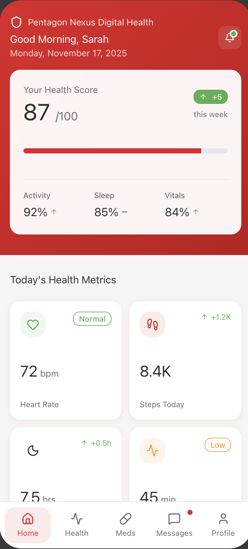
Opportunity Statement
Opportunity
Launch a B2B2C Digital Health Companion App, leveraging CGI’s health IT strengths + rising demand for consumer health technology.
Public sector projects = slow procurement, high political risk
Limited presence in high-growth private-sector markets (AI, healthcare, fintech)
Notes:
CGI’s business heavily relies on government IT contracts

Slide 20
Project Scope
In Scope
Market research & competitive analysis
As-Is process mapping
Functional + non-functional requirements
Solution options & evaluation matrix
ROI & implementation plan
Data model & DB schema
Out of Scope
Final implementation
Vendor procurement
Post-deployment support

Slide 21
Project Charter - Project Goal
Deliver a scalable, AI-enabled digital health product to strengthen CGI’s diversification and competitiveness.

Slide 22
Project Charter
Purpose:
Support CGI’s shift to digital with the Digital Health Companion App.
Key Deliverables:
Requirements & As-Is Flows
Solution options & selection
Database design
Final report
Success Factors:
Stakeholder alignment, Clear recommendations, Improved service agility
Constraints/Risks:
Data access, Timeline limits, Change resistance

Slide 23




Requirements & Analysis
2
Requirements Summary
As-Is Process Overview
To-Be Process
Increase private-sector revenue by 20% in 2 years
Achieve 100,000 users within 2 years
Position CGI as a top digital health app provider in Canada within 3 years

Slide 24
Requirements Summary
Business Requirements
Increase private-sector revenue by 20% in 2 years
Achieve 100,000 users within 2 years
Position CGI as a top digital health app provider in Canada within 3 years

Slide 25



Requirements Summary
Business Requirements
Key Functional Requirements
Increase private-sector revenue by 20% in 2 years
AI health insights
Continuous vitals monitoring
99.9% uptime< 3 sec response time
Accessibility (WCAG 2.1)
Data security (HIPAA, GDPR, PHIPA)
Cross-platform compatibility
Cloud scalability
Subscription + billing
Achieve 100,000 users within 2 years
Wearable device integration
FHIR/HL7 interoperability
Position CGI as a top digital health app provider in Canada within 3 years
Medication reminders
Provider-patient messaging

Slide 26
Requirements Summary
Non-Functional Requirements
99.9% uptime< 3 sec response time
Accessibility (WCAG 2.1)
Data security (HIPAA, GDPR, PHIPA)
Cross-platform compatibility
Cloud scalability

Slide 27
As-Is Process Overview
99.9% uptime< 3 sec response time
Accessibility (WCAG 2.1)
Data security (HIPAA, GDPR, PHIPA)
Cross-platform compatibility
Cloud scalability
CGI's existing workflow focuses on custom B2B enterprise projects:
Long RFP cycles
Manual onboarding
Limited automation
No direct consumer-facing support
No wearable data integration
Product analytics is limited to project-specific implementations
Gaps show inadequate support for the B2B2C digital product scale.

Slide 28
To-Be Process Overview
CGI shifts from custom B2B projects to a scalable B2B2C digital health platform:
Automated, fast onboarding
Reusable product components
Direct consumer engagement via mobile app
Wearable & IoT data integration
AI-powered health insights
Real-time product analytics
End-to-end digital support across providers & consumers
Enables CGI to scale nationally and grow private-sector revenue.

Slide 29
3
Solution Design & Evaluation
Solution Options
ROI Summary
Recommended Solution

Slide 30
Solution Options Reviewed
Option 1
Build the Digital Health Companion
Mobile + web app
Wearable integration
AI health insights
Subscription model
High scalability
Option 2
Do Nothing (Baseline)
Maintain current operations
No product diversification
Risk losing competitive position

Slide 31
ROI Summary (5-Year)
-367%
Option 2
Do Nothing (Baseline)
Option 1
Build the Digital Health Companion
 | Year 1 | Year 2 | Year 3 | Year 4 | Year 5
Total Cost | $1,080,000 | $190000 | $200,000 | $210,000 | $220,000
Total Benefits | $50,000 | $600,000 | $900,000 | $1,100,000 | $1,250,000
Net Benefit | –$1,030,000 | $410,000 | $700,000 | $890,000 | $1,030,000
ROI | -47% | 18% | 47% | 78% | 105%
105%
Payback period ≈ 2.5 years
Notes:
Initial Investment: High
Benefits:
New recurring revenue (B2B2C subscriptions)
Diversifies away from public-sector dependency
Scalable digital product with long-term growth

Slide 32
ROI Summary (5-Year)
Option 2
Do Nothing (Baseline)
Investment: None
Risks:
Continued overreliance on government contracts
Lost private-sector opportunities
No new revenue streams
Rising competitive disadvantage
105%
-367%
Option 1
Build the Digital Health Companion
Notes:
Conclusion
Option 1 provides strong financial return and strategic value; Option 2 results in long-term loss and stagnation.

Slide 33
ROI Summary (5-Year)
105%
-367%
Option 2
Do Nothing (Baseline)
Option 1
Build the Digital Health Companion
Investment: None
Risks:
Continued overreliance on government contracts
Lost private-sector opportunities
No new revenue streams
Rising competitive disadvantage

Slide 34
Evaluation Criteria
Criteria | Weight | Option 1 Digital Health Companion | Option 2 Do Nothing
Functional Coverage | 20% | 10 | 4
Integration & Scalability | 20% | 9 | 5
Compliance & Security | 15% | 10 | 6
Cost Efficiency | 15% | 7 | 9
Maintainability | 10% | 8 | 5
ROI (5-Year) | 20% | 9 | 2
Weighted Score | 100% | 8.9 | 5.2
Notes:
Evaluation Criteria (Weighted Scoring Model) Used to assess the two solution options based on functionality, scalability, cost, ROI, and long-term value.
🔹Evaluation Dimensions (with Weightings)
Functional Coverage – 20% Ability to meet business and technical requirements.
Integration & Scalability – 20% Supports interoperability (FHIR/HL7), wearable integration, and future growth.
Compliance & Security – 15% Meets healthcare privacy, consent, and security standards.
Cost Efficiency – 15% Balance between upfront investment and operational cost savings.
Maintainability – 10% Ease of support, upgrades, and long-term maintenance.
5-Year ROI – 20% Financial returns, payback period, revenue potential.
🔹Overall Weighted Scores
Option 1 – Build Digital Health Companion: 8.9 / 10
Option 2 – Do Nothing Baseline: 5.2 / 10
🔹Conclusion
Option 1 provides the highest value, long-term scalability, and strong financial ROI — making it the recommended solution.

Slide 35
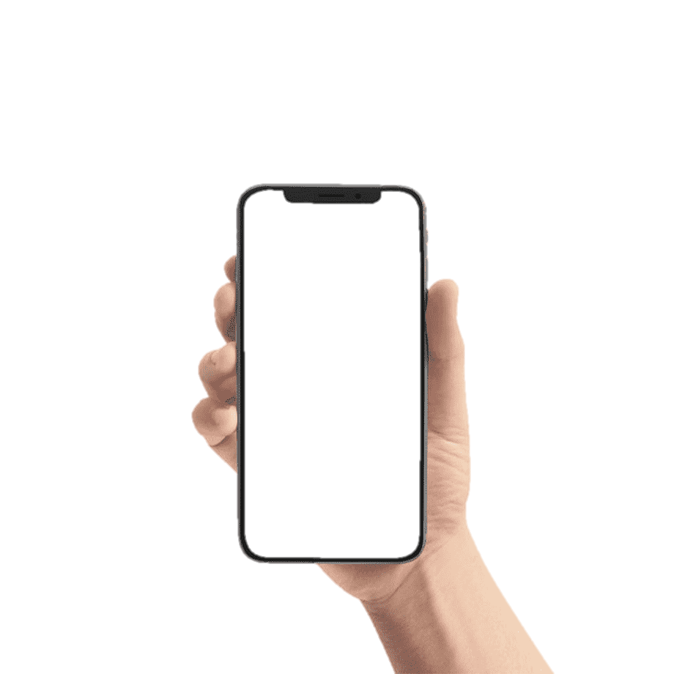
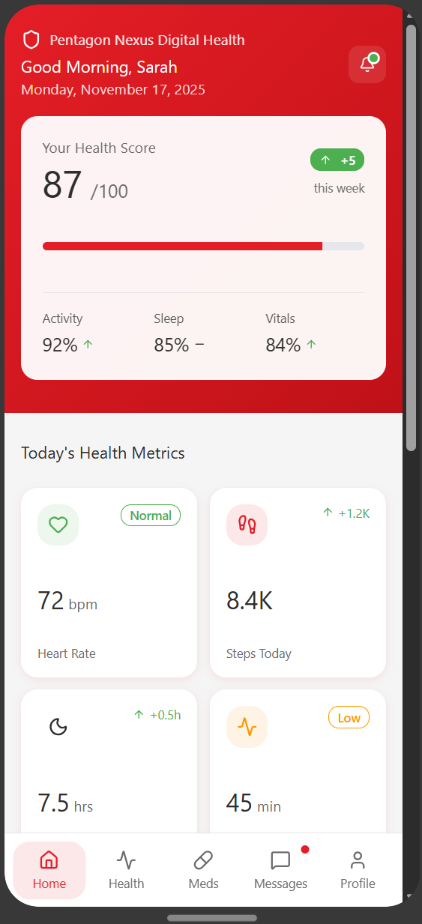
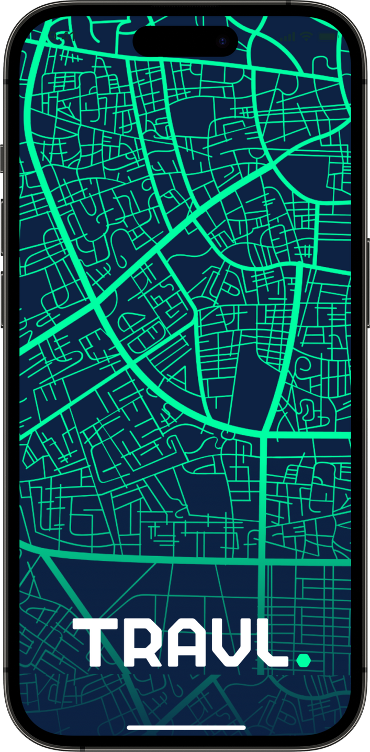
Recommended Solution
Option 1
Build the Digital Health Companion
Reasons:
High 5-year ROI (105%)
Supports diversification strategy
Aligns with market demand
Builds recurring revenue
Enhances CGI’s presence in digital health

Slide 36
Implementation Planning
4
Database & Data Model
Transition Requirements
Risks & Mitigation
Test Strategy
Implementation Strategy

Slide 37
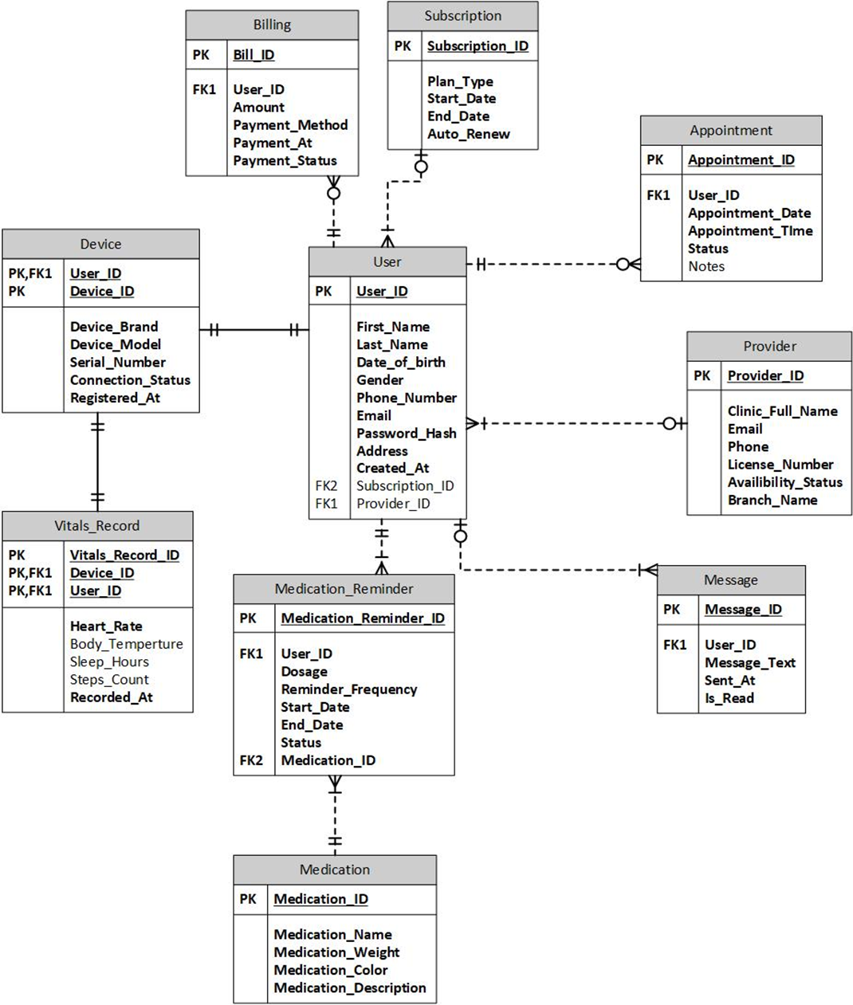
Database & Data Model Summary
Basic issues, ticket creation
L1
CGI
Core Entities:
User
Provider
Device
Vitals_Record
Medication
Medication_Reminder
Appointment
Message
Subscription
Billing
App-level fixes, pairing/reminder issues
L2
CGI
Code-level fixes, AI errors, API/FHIR issues
L3
Our Team
Notes:
Key Relationships
User ↔ Device ↔ Vitals_Record (one user → many devices → many vitals records)
User ↔ Medication_Reminder ↔ Medication
User ↔ Appointment
User ↔ Message
User ↔ Subscription ↔ Billing
Relational database structured around 10 core entities (User, Provider, Device, Vitals_Record, Medication, Medication_Reminder, Appointment, Message, Subscription, Billing)
Fully normalized to Third Normal Form (3NF) → avoids redundancy, ensures consistency, improves query performance
Supports high-volume vitals streaming and secure health-data storage
Designed for interoperability with wearable APIs & healthcare systems

Slide 38
Transition Requirement
Support Model
Our Team
CGI
Basic issues, ticket creation
L1
CGI
App-level fixes, pairing/reminder issues
L2
CGI
Code-level fixes, AI errors, API/FHIR issues
L3
Our Team
Advanced troubleshooting & hotfixes
Wearable API maintenance
FHIR/HL7 interoperability support
AI model updates & monitoring
Platform governance & compliance
Cloud hosting & security
SLA/usage reporting
Full data ownership
Notes:
Our team:
Advanced troubleshooting & hotfixes
Wearable API maintenance
FHIR/HL7 interoperability support
AI model updates & monitoring
CGI:
Platform governance & compliance
Cloud hosting & security
SLA/usage reporting
Full data ownership

Slide 39



Risks & Mitigation (Top 3 Risks)
Wearable integration failures
Incorrect or inconsistent vitals data
AI misclassification or incorrect insights
Notes:
⭐ Top 3 Major Risks & Mitigations (One-Slide Version)
1. Incorrect or inconsistent vitals data
Risk: Wearable sensor errors or Bluetooth disconnection cause false readings. Mitigation: Device validation, accuracy checks, fallback data verification. (High severity — R1)
2. Wearable integration failures
Risk: Fitbit / Garmin / Apple Health API updates break data sync. Mitigation: Regular SDK updates, integration regression testing, monitoring API changes. (High severity — R3)
3. AI misclassification or incorrect insights
Risk: AI produces wrong predictions, causing user confusion or anxiety. Mitigation: Medical expert review, continual model retraining, clear disclaimers. (High severity — R7)

Slide 40
Test Strategy Summary
Testing Scope
Validate core features: vitals monitoring, device integration, reminders, messaging, AI insights
Ensure security, performance, and interoperability (FHIR/HL7)
Test Levels
Unit Testing
Integration Testing
System Testing
UAT
Regression tests
Tool | Purpose
Jira, Azure DevOps | Requirement traceability and defect tracking
Selenium, Appium | Regression and cross-platform UI testing
Postman | Validate API integrations with wearables and hospital systems
JMeter | Load and stress testing
OWASP ZAP, Burp Suite | Vulnerability scanning and penetration testing
Notes:
Environment Setup:
Development Environment: Internal CGI environment for initial builds.
Test Environment: Production setup environment(s) will be provisioned, mirroring hardware, OS, browsers, network, security settings, and third-party integrations.
UAT Environment: Hosted on secure regional cloud servers.

Slide 41
Test Strategy Summary
Testing Scope
Validate core features: vitals monitoring, device integration, reminders, messaging, AI insights
Ensure security, performance, and interoperability (FHIR/HL7)
Test Levels
Unit Testing
Integration Testing
System Testing
UAT
Regression tests
Tool | Purpose
Jira, Azure DevOps | Requirement traceability and defect tracking
Selenium, Appium | Regression and cross-platform UI testing
Postman | Validate API integrations with wearables and hospital systems
JMeter | Load and stress testing
OWASP ZAP, Burp Suite | Vulnerability scanning and penetration testing
Phases:
Unit Testing
Integration Testing
System Testing
UAT
Regression tests
Tools:
Postman, JMeter, Jira, Appium
Focus areas:
Security
Performance
Usability
Interoperability

Slide 42
Implementation Strategy
1
2
3
Pilot
Controlled Expansion
Full Rollout
Deploy to 1 hospital + small patient group
Validate vitals sync, AI accuracy, security & compliance
Onboard additional healthcare partners
Monitor adoption, resolve defects, optimize performance
Nationwide bilingual release (EN/FR)

Slide 43
5
Conclusion

Slide 44
Conclusion
Business Value
Strategic Impact
105% ROI over 5 years
Creates scalable, recurring revenue
Reduces reliance on government projects
Expands CGI into the private digital health market
Organizational Benefits
Strengthens CGI’s digital health leadership
Improves provider partnerships through secure, real-time data
Notes:
Final Statement:
The Digital Health Companion is not only a product recommendation—it is a strategic shift that drives diversification, innovation, and long-term growth for CGI.

Slide 45
Thank you!

Slide 46
References
CGI Inc. (2025a). About us. https://www.cgi.com/en/about-us
CGI Inc. (2025b). Investment profile. https://www.cgi.com/en/investors/investment-profile
CGI Inc. (2025c). Healthcare solutions. https://www.cgi.com/en/health
McKinsey Digital. (2023). Technology Trends Outlook 2023. https://www.mckinsey.com/mti/technology-trends-outlook
Seeking Alpha. (2025, July 24). CGI Q3 Preview: U.S. Federal Exposure Is a Huge Risk. https://seekingalpha.com/article/4804218
European Union. (2018). General Data Protection Regulation (GDPR). Official Journal of the European Union.

